Slide 1
AGE AND GENDER CLASSIFICATION APPLICATION
VIP PROJECT PRESENTATION
Group 4

Slide 2
Motivation and Goals
To apply the image processing knowledge into machine
Create an application that can help the human to classify gender and age group from facial images
Benchmarking between the proposed models
Deploy the application to public
Notes:
In the motivation and goals, we aim to apply the image processing knowledge into machine. Besides, creating an application that can help the human to classify gender and age group from facial images. Furthermore, benchmarking between the proposed models and at the end deploy the application to the public.

Slide 3
The Dataset
Gender
Age
200k of images in gender classification
Split to 3 folder
Train, Validate and Test
UTKFace
Consist 23.7k images in age 0 – 116
AGFW
Consist 11 folder of the age from 20-94
Bins the images into 4 categories
Child (1-9), Adolescene (10-19), Adult (20-59) and Senior Adult (>60)
Notes:
In order to create the models, we obtained two dataset which is Gender and Age dataset.
In the gender dataset we obtained, the dataset is splitted into three folders which are Train, Validate and Test with a total of 200k images.
On the other hand, the Age dataset we obtained from two sources which are UTKFace and AGFW. In the UTKFace, it consists of 23.7k images from age 0 to 116. Apart from that, the AGFW consists of 11 folders of the age from 20 until 94. At the end, we bin the age dataset into 4 categories which are Child, Adolescent Adult and Senior Adult.

Slide 4




Main Tools and Libraries
Streamlit
Tensorflow
Keras
OpenCV
Notes:
Other than the dataset, these are the main tools for us to build the models and deployment. For example, the tensorflow, keras and opencv we used in image processing. For example, TensorFlow is a highly flexible system with multiple models and versions of the models provided and Keras has an user-friendly API to create the neural network.
Meanwhile, the streamlit we used for deployment. There are also some of the common libraries we used in our project such as pandas, os, numpy etc.

Slide 5
Project Flow
Data preprocessing
Train Test Split (ImageDataGenerator)
Feature Extraction
Classification Layer
Analysis Result
Deployment
Notes:
So in our project flow, it consists of 6 stages which are data preprocessing, train test split (imagedatagenerator), feature extraction, classification layer, analysis result and deployment.

Slide 6
Data Preprocessing
Gender
Age
Make used of two dataset and merge them into 4 categories
Train (3062, 3272,2595,2690)
Only partial data are used in our experiment
Train (26862,27853)
Validation (6174,6089)
Test (8459,10426)
Face Detection
Applied face detection algorithm in deployed application
Notes:
In the data preprocessing, for the gender part, we only used partial data in our experiment. Meanwhile the age group we bins into categories as mentioned in the previous slide.
For the face detection, we have applied it in our deployed application. This is because all the dataset we obtain, face are aligned and centered so we do not apply this algorithms in to it.

Slide 7
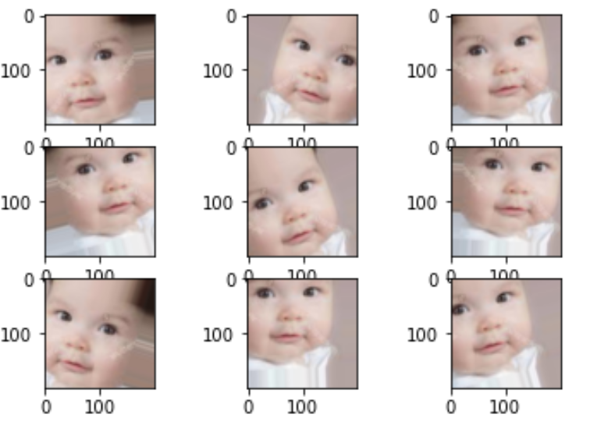
Data Preprocessing
Data Augmentation
rotation_range = 30
horizontal_flip = True
width_shift_range=0.2
height_shift_range=0.2
fill_mode = "nearest"
Notes:
The reason we apply data augmentation is because we can let the model know more of the angle of the image such as the function applied above. Throughout this process, model will be more robust towards the images from different angle

Slide 8
CNN Architecture
VGG16 Architecture
ResNet50 Architecture

Slide 9
Classification Layer
Average Pooling
Added Layers
Dense Layer (512 Nodes)
Dropout Layer (0.5)
Sigmoid Layer
Gender (2 Classes)
Softmax Layer
Age Group (4 Classes)s

Slide 10
Model Compilation
Trainable Layers
Freeze all the trainable layers
Optimizer
Adam
Learning Rate
0.001

Slide 11
Model Setup
VGG16 Gender
VGG16 Age Group

Slide 12
Model Evaluation
VGG16 Gender

Slide 13
Model Evaluation
VGG16 Age Group

Slide 14
Model Setup
ResNet50 Gender
ResNet50 Age Group

Slide 15
Model Evaluation
ResNet50 Gender

Slide 16
Model Evaluation
ResNet50 Age Group

Slide 17
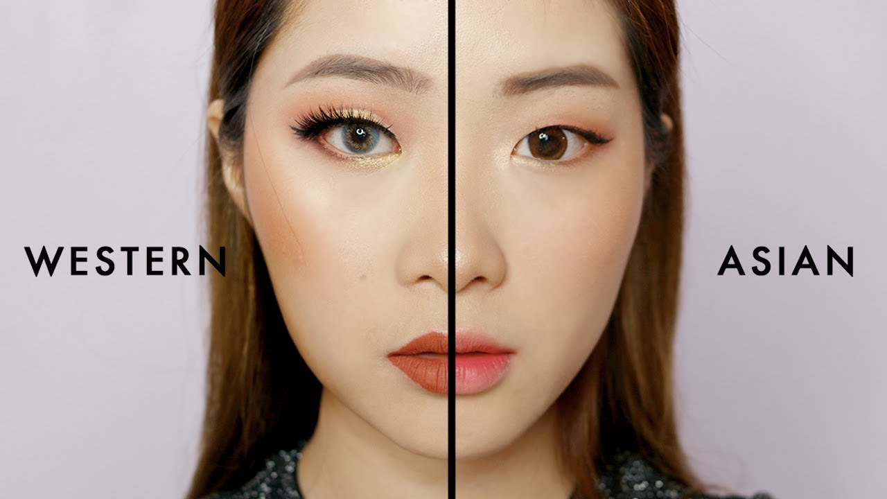
Limitations
Age Group Classifcation
Not enough dataset obtained to conduct the age group predictions
Most of the data are rely on American/Europe Look
Future Improvement
Train the model with multiple regions of people
Improve the stability of the Age Group Classifcation Models

Slide 18
Conclusion
Data Preprocessing (Data Augmentation)
Numerous Deep Learning Models
Transfer Learning
Deployment (Streamlit)

Slide 19
DEMO

Slide 20
THANK YOU

Slide 21
QnA

